Slide 1


Project name: Solar Power Battery Team members: Lauren Lugo, Tarik Dawson, Clement Ong, Nathan Gil

Slide 2

Executive Summary
Problem statement:
Clean, accessible, power to preserve the environment
Provide the user with an independent solar power generating system that can charge both AC and DC devices
Everything needs power, computers, smartphones, accessories, etc.
Create security by providing a battery to switch to for discrepancies in generation of power from solar panels

Slide 3
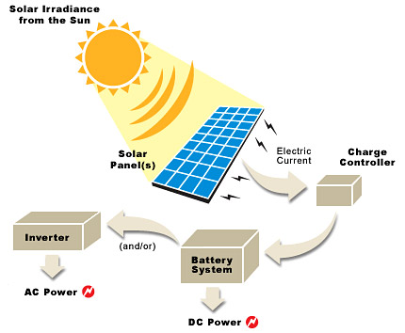
Project description
Solution proposal:
Develop independent power grid using solar panels that can charge the majority of items throughout the day and night

Slide 4
System Overview
Clement
DC Bus
DC-AC Inverter
AC Load
Tarik
Solar Panel
DC-DC Converter
DC Load
Lauren
PWM Generator
Batteries
MPPT Algorithm (MCU)
Voltage Regulation
Nathan
Computer Application
Phone Application

Slide 5
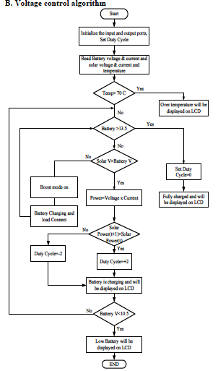
MPPT Subsystem
MCU evaluates the current sensor output from the solar panel and battery to determine to increase or decrease charge on the battery.
Handles communication through wifi to application and website.
Provide PWM to DC-DC converter to regulate the voltage provided

Slide 6
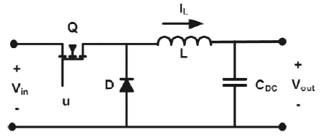
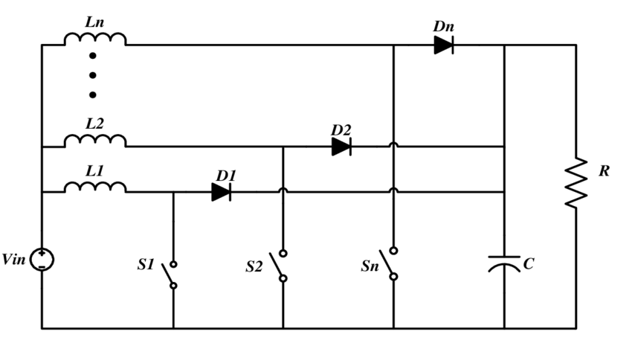
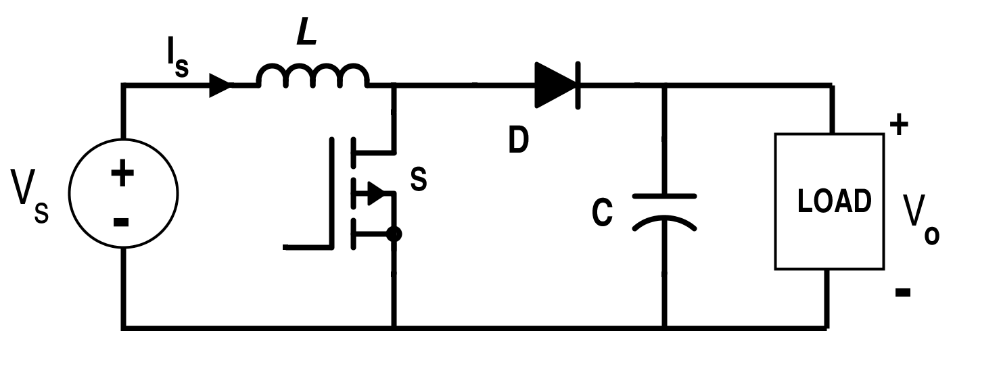
DC-DC Converter Subsystem
Subsystem contains buck and boost, which will give a desired voltage determined by the MPPT system
Uses multiple phases to allow for better transfer of power along the circuit.

Slide 7
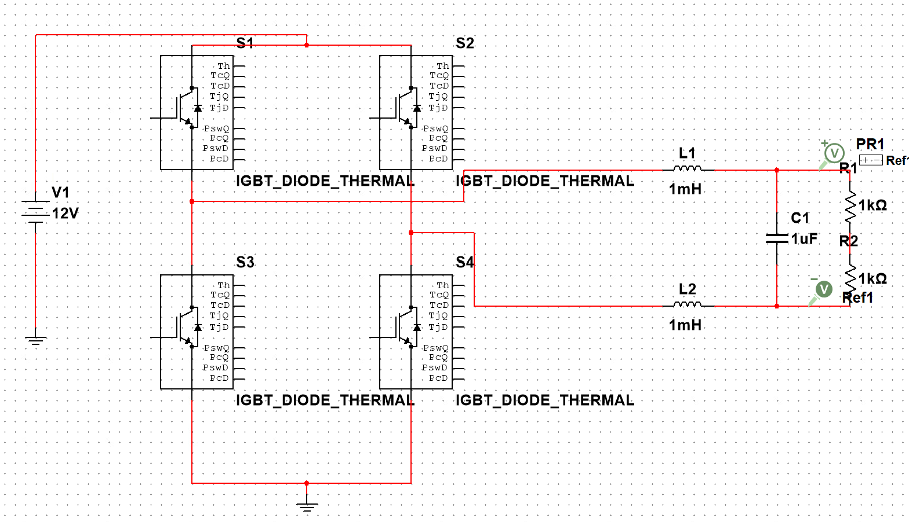
DC-AC Inverter System
Initial H-bridge design made up of four IGBTs and two loads
Take in 12V DC, convert to 12V AC, and step-up to 165V AC through use of transformer

Slide 8
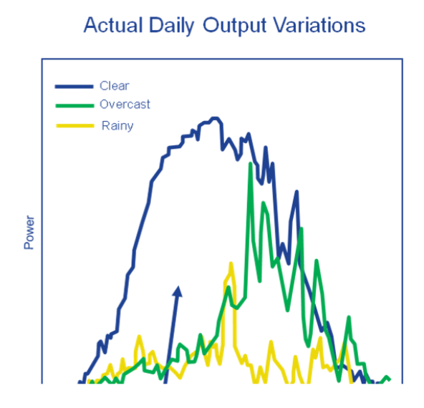
Application and Website
Gathers data from solar power system through ESP32
Power Harnessing throughout the day
Monitors Battery Level
Detects connected devices
Discharging or charging mode
Display data to user for easy access
Access system away from home
Makes the product scalable for other solar powered systems not created by our team
Provides easy access to everyone
App will be made only for android
Website will combat this with easy access for everyone (iOS)

Slide 9
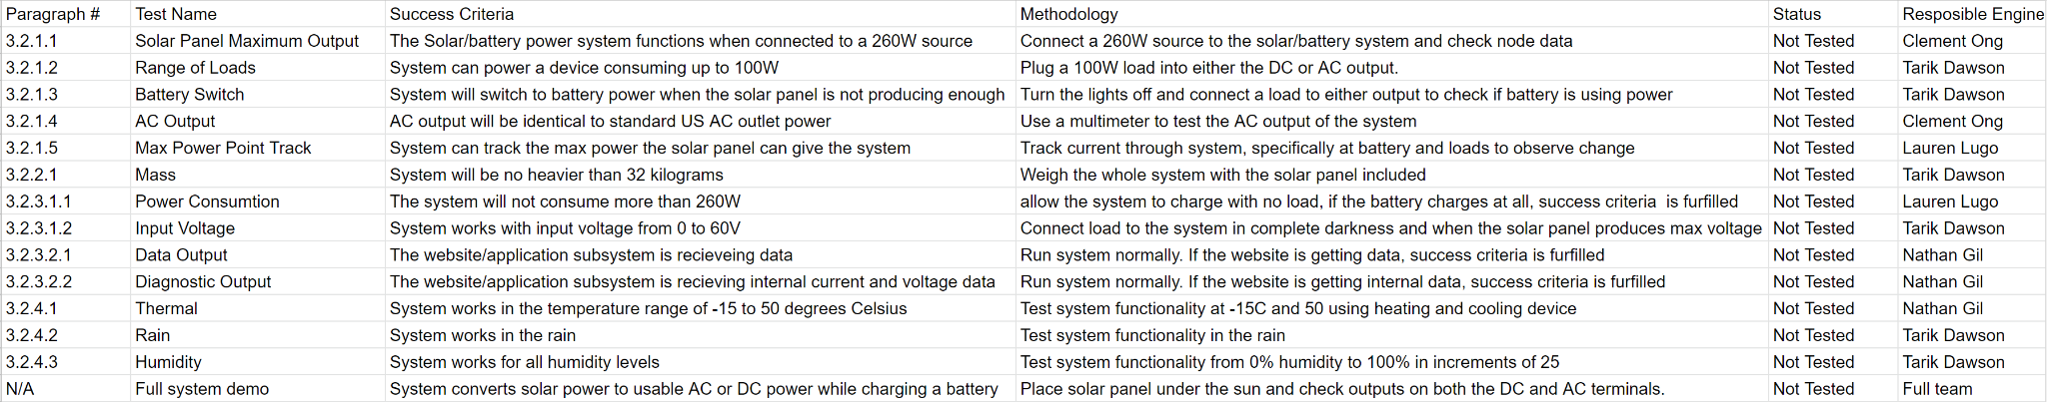
Validation Plan

Slide 10
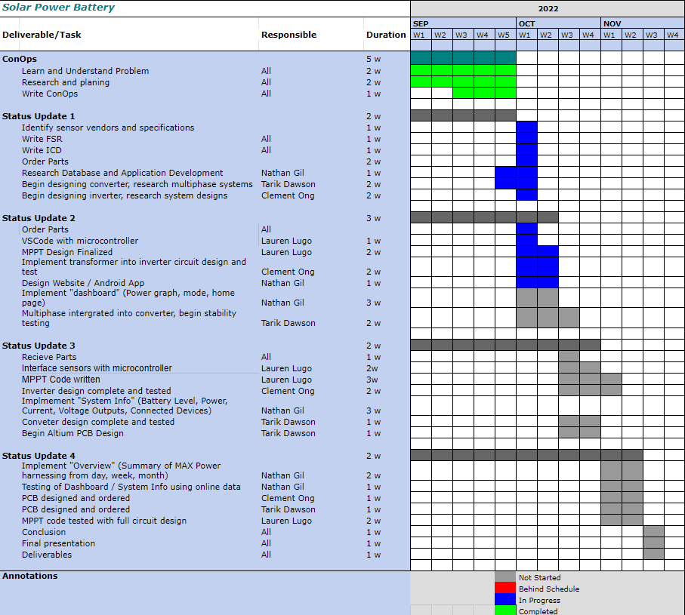
Execution Plan

